Slide 1

Productivity Commission
Philanthropy Inquiry
The briefing will commence shortly, please keep your microphone on mute
Philanthropy Inquiry webinar
Alex Robson, Commissioner
Julie Abramson, Commissioner
Krystian Seibert, Associate Commissioner

Slide 2
Acknowledgment of Country
I'd like to begin by acknowledging the Traditional Custodians of the lands on which we meet today. I would also like to pay my respects to Elders past and present.

Slide 3
A snapshot of the Commission
\
Independent research and advisory body
Economic, social and environmental issues
Evidence-based analysis
Policy ideas ↔ actionable outcomes
Inform
and educate
Better policies in the long-term interest of the Australian community
Philanthropy inquiry webinar

Slide 4
Key operating principles
\
Independent
Open and transparent
Economy and community-wide perspective
Evidence based
Public consultation
Testing policy ideas
Educate and inform
Philanthropy inquiry webinar

Slide 5

What we will cover today
Brief overview of the inquiry scope
Introduce the inquiry process
Explain the different ways you can contribute to the inquiry
Respond to your questions and answers
This presentation, without the Q and A, is being recorded and will be placed on the website
Philanthropy inquiry webinar

Slide 6
Scope: Terms of Reference
1
2
3
Trends and motivations for giving in Australia
Identify opportunities for, and obstacles to increasing philanthropic giving
in Australia
Recommend ways to respond to these opportunities and obstacles
Guided by terms of reference, past reviews and participant input and feedback
Philanthropy inquiry webinar

Slide 7
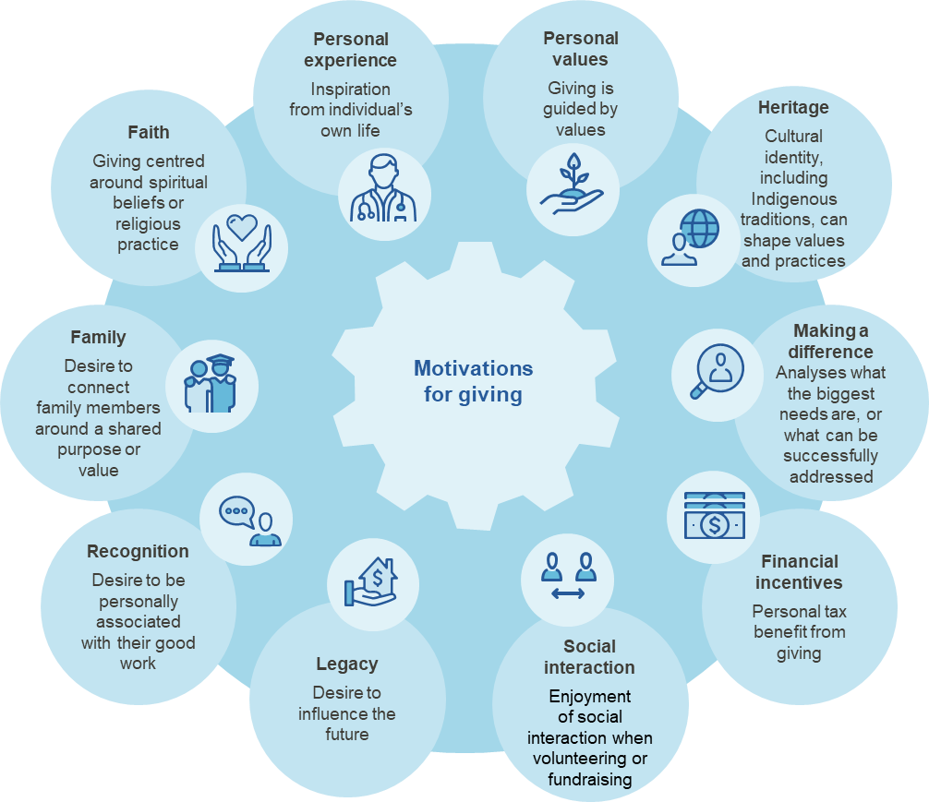
1. Trends and motivations for giving
Topics of interest
Why people do (and do not) give
Who gives, including different characteristics (age, gender, income)
Advantages and disadvantages of philanthropy as a source of revenue
Data, insights and case studies including those that are not publicly available
Alternative giving vehicles currently unavailable in Australia
Figure 1. Motivations for giving
Philanthropy inquiry webinar

Slide 8

2. Opportunities and obstacles
Topics of interest
Regulatory issues and barriers to giving including:
  regulatory burden
  any gaps in regulation
  regulator roles and responsibilities
Deductible gift recipient framework
  issues and opportunities
Tax concessions available to not for profits
Ability of donors to assess charity effectiveness
Other issues you identify
Scope

Slide 9

3. Reform opportunities
Topics of interest
Data and information gaps about philanthropy
Public strategies to increase the status of giving
Evidence on the impacts, costs and benefits of reform opportunities
Other measures to support philanthropy in Australia
Scope

Slide 10
Inquiry process and milestones
By 11 May
5 May 2023
Final report to Government
November
Initial submissions due
Commission publishes draft report and invites further submissions
March 2023
Call for submissions paper released
June/July 2023
Roundtable sessions
February 2024
Public hearings
START
END
2023
2024
PC reporting
Public engagement
Key Dates

Slide 11
How you can contribute
Register your interest to receive updates
Make a submission:
Individual or organisation
Any length
Written or video
Covering as few or many issues you wish
Submissions are made public
Leave a comment
Call or meet with us
Speak with us at a round table or public hearing
Contributing to the inquiry

Slide 12

Questions
Please use the comment box to alert the moderator that you have a question
Further questions can be directed to
philanthropy@pc.gov.au
Questions

Slide 13
End
If you have joined by phone: *6 to mute/unmute
philanthropy@pc.gov.au

